Slide 1


ATLIQ EV Motors
AtliQ Motors is an automotive giant from the USA specializing in electric vehicles (EV). In the last 5 years, their market share rose to 25% in electric and hybrid vehicles segment in North America. As a part of their expansion plans, they wanted to launch their bestselling models in India .

Slide 2
Problem statement
In India AtliQ’s market share is less than 2%. Bruce Haryali, the chief of AtliQ Motors India wanted to do a detailed market study of existing EV/Hybrid market in India before proceeding further.

Slide 3
Objective
The primary objective of this market study is to conduct a comprehensive analysis of the electric vehicle (EV) and hybrid vehicle market in India, focusing on key factors that influence consumer preferences, adoption rates, competitive landscape, and regulatory policies. The study aims to identify growth opportunities for AtliQ Motors, assess the viability of launching their bestselling EV models in India, and provide actionable insights on market trends, consumer behavior, and strategic approaches to increase market share beyond the current 2%. The findings will help AtliQ Motors India tailor their marketing, sales, and distribution strategies to successfully expand their presence in the Indian automotive market.

Slide 4
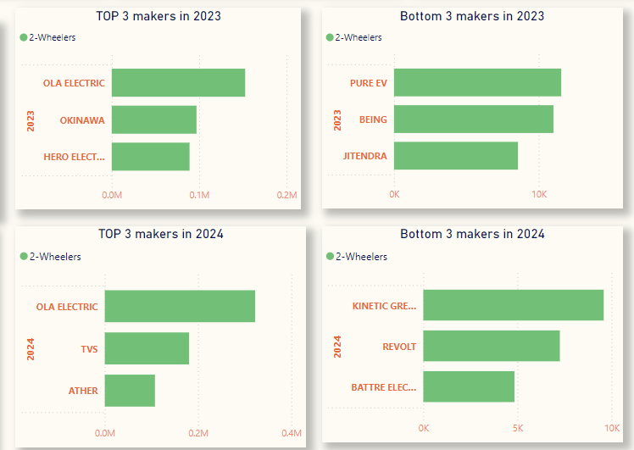
1. List the top 3 and bottom 3 makers for the fiscal years 2023 and 2024 in
terms of the number of 2-wheelers sold.

Slide 5
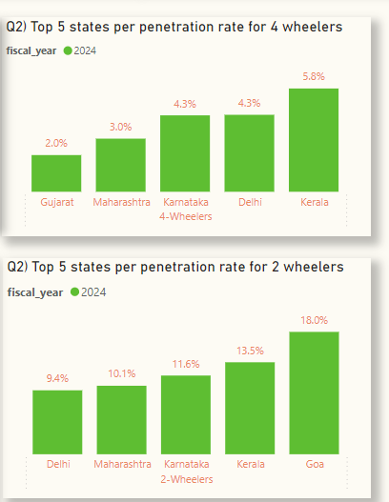
2. Identify the top 5 states with the highest penetration rate in 2-wheeler
and 4-wheeler EV sales in FY 2024.

Slide 6
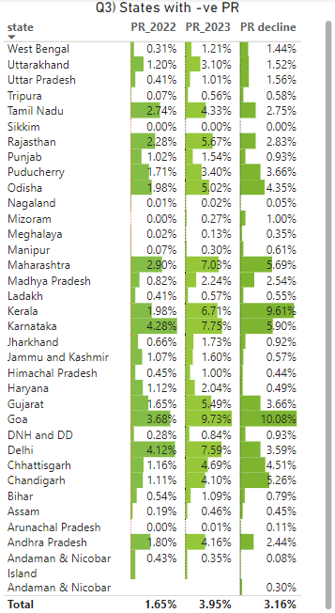



3. List the states with negative penetration (decline) in EV sales from 2022
to 2024?

Slide 7
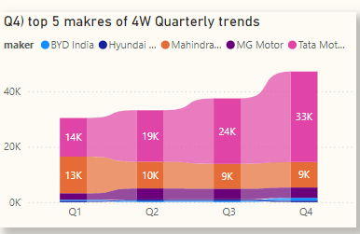
4. What are the quarterly trends based on sales volume for the top 5 EV
makers (4-wheelers) from 2022 to 2024?
Top 5 Makers are 1. Tata Motors 2. Mahindra & Mahindra 3.MG Motors 4.BYD India 5.Hyundai

Slide 8
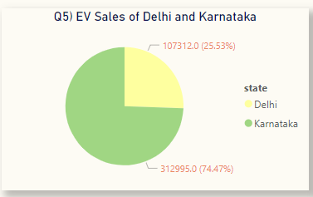
5. How do the EV sales and penetration rates in Delhi compare to
Karnataka for 2024?
EV Sales: Delhi:107312 Karnataka :312995 Penetration Rate: Delhi:6.76% Karnataka :7.84%

Slide 9
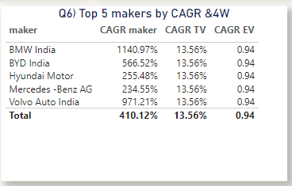
6. List down the compounded annual growth rate (CAGR) in 4-wheeler
units for the top 5 makers from 2022 to 2024.

Slide 10
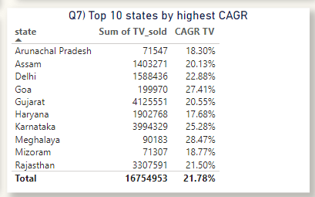
7. List down the top 10 states that had the highest compounded annual
growth rate (CAGR) from 2022 to 2024 in total vehicles sold.

Slide 11
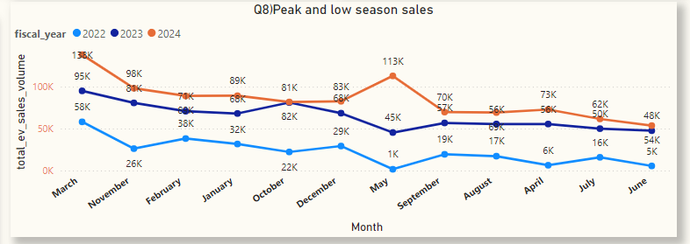
8. What are the peak and low season months for EV sales based on the
data from 2022 to 2024?
Peak season: March & May In 2024 , Low season: June in all years

Slide 12
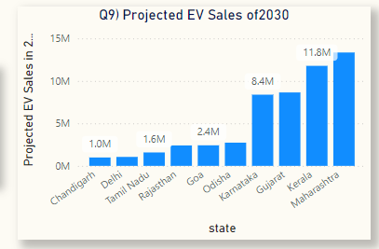
9. What is the projected number of EV sales (including 2-wheelers and 4-
wheelers) for the top 10 states by penetration rate in 2030, based on the
compounded annual growth rate (CAGR) from previous years?

Slide 13
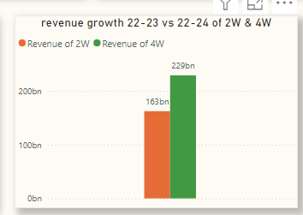
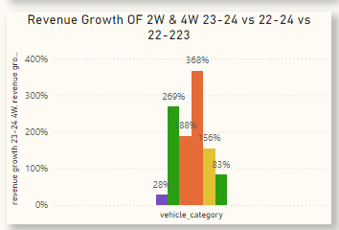
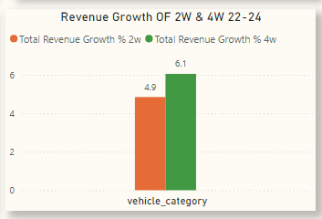
10. Estimate the revenue growth rate of 4-wheeler and 2-wheelers
EVs in India for 2022 vs 2024 and 2023 vs 2024, assuming an average
unit price.

Slide 14
Secondary Research ANALYSIS
1. What are the primary reasons for customers choosing 4-wheeler EVs in 2023 and 2024 (cost savings, environmental concerns, government incentives)?
3. Government Subsidies FAME II Scheme Subsidies
The FAME II scheme, introduced in 2019, is a central government initiative to promote EV adoption and local manufacturing of EV components, including motors. Production-Linked Incentive (PLI) Scheme
The PLI Scheme for Advanced Chemistry Cell (ACC) Battery Storage and the PLI Scheme for Auto and Auto Components offer incentives for manufacturing EV components, including motors.
1. Customer Concerns
Fuel and Maintenance Costs: EVs save on fuel, as electricity costs significantly less than petrol or diesel. Maintenance is also cheaper due to fewer moving parts.
Incentives Reducing Upfront Costs: Government subsidies, like reduced GST or direct financial aid, lower the high initial cost of EVs, making them accessible to a broader audience. Example: In India, the FAME II scheme provides incentives of up to ₹1.5 lakh for 4-wheelers.
2. Environmental Concerns
Carbon Footprint Reduction: Environmentally conscious buyers prefer EVs to minimize greenhouse gas emissions.
Government Support for Green Goals: Many countries aim for net-zero emissions, pushing customers to adopt cleaner technologies. Example: India's pledge to achieve net-zero by 2070 boosts EV awareness and adoption.

Slide 15
2. How do government incentives and subsidies impact the adoption rates of 2-wheelers and 4-wheelers? Which states in India provided most subsidies?
1. Impact on EV Adoption Rates
Two-Wheelers (E-Bikes and Scooters)
High Affordability: Subsidies significantly reduce the upfront cost, making 2-wheelers more attractive for middle-class and rural consumers.
Increased Accessibility: Lower ownership costs enable first-time buyers to switch from ICE vehicles to EVs.
Leading Role in EV Adoption: As of 2024, 2-wheelers dominate EV sales in India, accounting for 75-80% of total EV registrations.
Four-Wheelers (Cars and Commercial Vehicles)
Cost Parity with ICE Vehicles: Subsidies bridge the price gap, encouraging customers to explore EVs.
Commercial Fleet Uptake: Incentives on 4-wheelers have driven adoption in ride-hailing, logistics, and public transportation sectors.
Slower Growth vs. 2-Wheelers: Higher initial costs and range concerns still limit widespread 4-wheeler adoption despite subsidies.
2. States Providing the Most Subsidies
1. Maharashtra
EV Policy Highlights:
Up to ₹10,000 per kWh of battery capacity for 4-wheelers (capped at ₹1.5 lakh).
Subsidies for 2-wheelers up to ₹5,000 per kWh (capped at ₹25,000).
Waiver on road tax and registration fees.
Impact: One of the top states in EV registrations, contributing 11-12% to India's EV sales.
2. Gujarat
EV Policy Highlights:
Subsidy of ₹10,000 per kWh for 2-wheelers and 4-wheelers, with caps of ₹20,000 and ₹1.5 lakh, respectively.
Support for EV manufacturing, including motors and batteries.
Impact: High adoption due to effective implementation and financial aid.

Slide 16
3. How does the availability of charging stations infrastructure correlate
with the EV sales and penetration rates in the top 5 states?
Maharashtra (4-Wheeler Penetration: 3.0%, 2-Wheeler Penetration: 10.1%)
Maharashtra, with cities like Mumbai and Pune leading in charging station installations, shows solid penetration rates, particularly for 2-wheelers. The extensive charging infrastructure has encouraged adoption, though there is still room for growth in 4-wheeler penetration.
Urban charging accessibility has made Maharashtra an important EV market, especially for daily commutes where charging convenience is critical.
Karnataka (4-Wheeler Penetration: 4.3%, 2-Wheeler Penetration: 11.6%)
Karnataka’s cities, like Bengaluru, have one of the densest networks of charging stations in India, which contributes to high EV adoption. The state’s commitment to charging infrastructure has encouraged EV usage among daily commuters, particularly for 2-wheelers.
This availability of charging options supports a strong penetration rate, especially in urban centers where consumers value easy access to chargers.

Slide 17
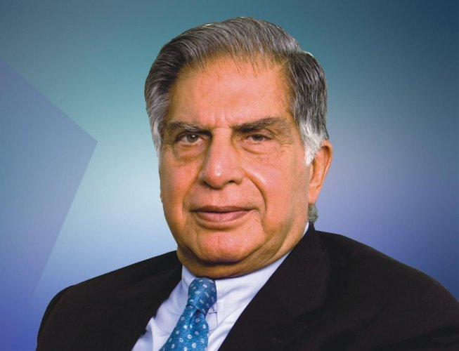
4. Who should be the brand ambassador if AtliQ Motors launches their
EV/Hybrid vehicles in India and why?
4. Ratan Tata (Industrialist and Philanthropist)
Why: Ratan Tata is a highly respected figure in India, known for his ethics, social impact, and love for innovation. His association with an EV brand would highlight reliability, trustworthiness, and social responsibility.
Focus on Social Good: Ratan Tata’s image aligns well with the vision of EVs as a solution for sustainable development and a cleaner environment.
Appeal Across Demographics: Tata’s reputation resonates with a wide range of audiences, including both young and mature consumers, making him an ideal ambassador for a brand that aims to establish trust and authority.

Slide 18
5. Which state of India is ideal to start the manufacturing unit? (Based on subsidies provided, ease of doing business, stability in governance etc.)
Karnataka
Subsidies and Incentives: Karnataka provides incentives like land concessions, subsidies on electricity, and capital investment subsidies for EV and battery manufacturing.
Ease of Doing Business: Bengaluru, Karnataka’s capital, is a hub for technology and innovation, offering an environment conducive to business, especially for tech-driven industries.
Supportive Ecosystem: Karnataka is home to numerous tech startups, R&D centers, and educational institutions, making it a good choice for high-tech manufacturing and innovation in the EV sector.
Government Policies: The state has a dedicated EV policy aimed at attracting investments in EV manufacturing and promoting research and development.

Slide 19
6. Your top 3 recommendations for AtliQ Motors.
Top 3 Recommendations for AtliQ Motors
1. Prioritize Sales and Marketing in High-Penetration States: Maharashtra and Karnataka have high EV penetration rates, so focus on boosting sales in these states. To increase brand awareness in other regions, conduct marketing campaigns, organize test drives, and showcase your products to educate potential customers.
2. Emphasize 4-Wheelers in Product Strategy: While demand for both 2-wheelers and 4-wheelers is forecasted to grow, 4-wheelers are expected to see significant increases. Prioritize your 4-wheeler offerings while maintaining a strong presence in the 2-wheeler market.
3.Expand Marketing Efforts in High-Selling Regions and Consider Strategic Partnerships: Sales are currently stronger in the north-west and southern regions than in the north and north-east. Increase marketing in these high-selling areas to build on existing demand. Additionally, partnering with Tata Motors, which has strong EV sales, could offer mutual benefits and help grow AtliQ’s presence in the market.

Slide 20
Thank you

